Slide 1
Encoder-Decoder with Atrous Separable Convolution for Semantic Image Segmentation, ECCV 2018
COMPUTER VISION LAB
22211226 JHNam

Slide 2
CONTENT
Introduction
Methods
Experimental Evaluation

Slide 3
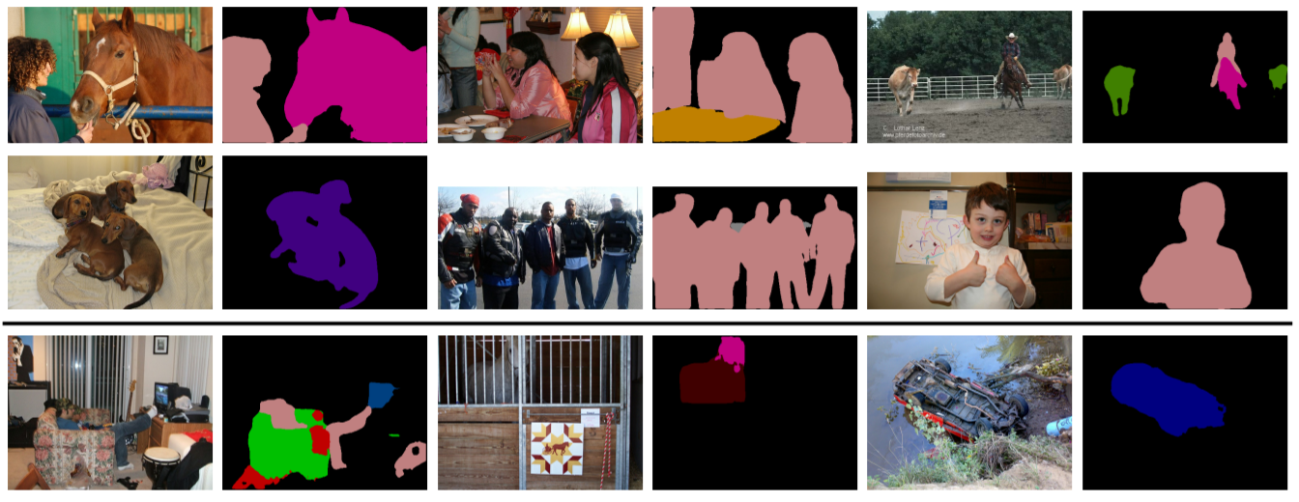
Introduction
Semantic Segmentation
Pixel-wise classification

Slide 4
Introduction
Semantic Segmentation
Approach ⇒ Fully-Convolutional Neural Networks
1. Spatial Pyramid Pooling Module : Captures rich contextual information by pooling features at different resolution
2. Encoder-Decoder Structure : Obtain sharp object boundaries

Slide 5
Introduction
Semantic Segmentation
Approach ⇒ Fully-Convolutional Neural Networks
1. Spatial Pyramid Pooling Module
2. Encoder-Decoder Structure
integration
DeepLabV3+

Slide 6
Introduction
Semantic Segmentation
DeepLabV3
Parallel Atrous Convolution
Cascade Atrous Convolution
PSPNet
Pooling operations at different grid scales

Slide 7
Introduction
Pooling + Convolution with striding operations within the network backbone
Semantic Segmentation
DeepLabV3
Parallel Atrous Convolution
Cascade Atrous Convolution
PSPNet
Pooling operations at different grid scales
Detailed Information related to object boundaries is missing

Slide 8
Introduction
Semantic Segmentation
DeepLabV3 ⇒output_stride(=input resolution/output resolution) is related to performance
Parallel Atrous Convolution
Cascade Atrous Convolution
PSPNet
Pooling operations at different grid scales

Slide 9
Introduction
Semantic Segmentation
Dillema : Abstract Representation ↔ Semantic segmentation performance
Extract more abstract representation from input image ⇒ output feature map resolution ↓ ⇒ output_stride ↑ ⇒ semantic segmentation performance ↓
Invariance of DNN for semantic segmentation is bad!!

Slide 10
Introduction
Main Keyword
Atrous Spatial Pyramid Pooling
Depthwise Separable Convolution
Xception Network
Xception = Extreme Inception = Depthwise Separable Convolution + Inception V3

Slide 11
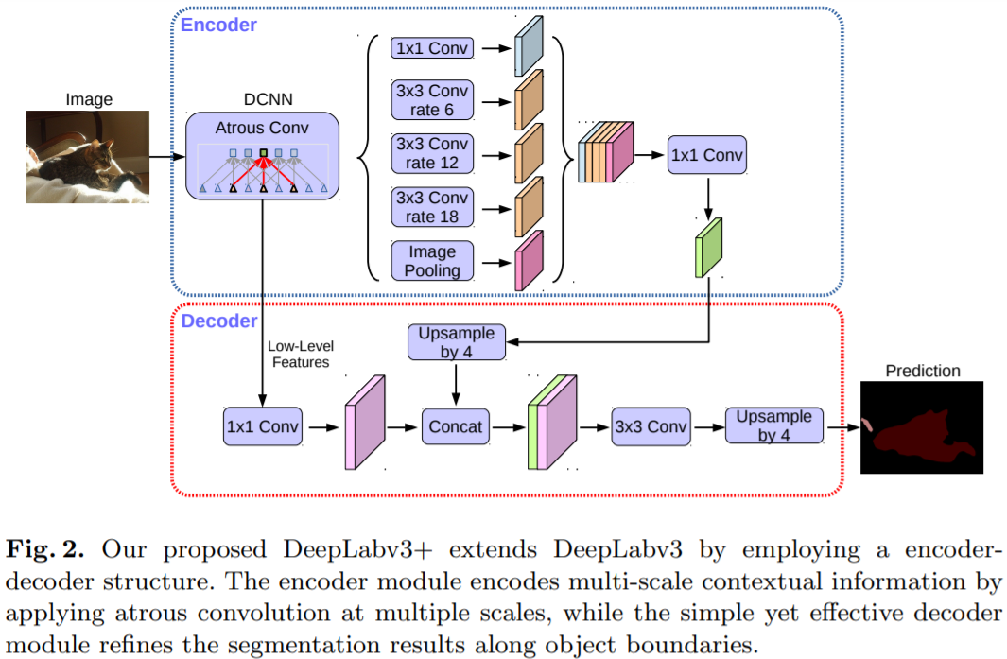
Method
Overall Network

Slide 12
Method
DeepLabV1 vs DeepLabV2 vs DeepLabV3 vs DeepLabV3+
 | Encoder | Decoder | Post-processing
DeepLabV1 | Modified VGG16 | ASPP + Upsampling | DenseCRF
DeepLabV2 | Modified ResNet50 | ASPP + Upsampling | DenseCRF
DeepLabV3 | Modified ResNet101 | ASPP + Upsampling (Parallel|Cascade) | X
DeepLabV3+ | Modified Xception | ASPP + Decoder | X

Slide 13
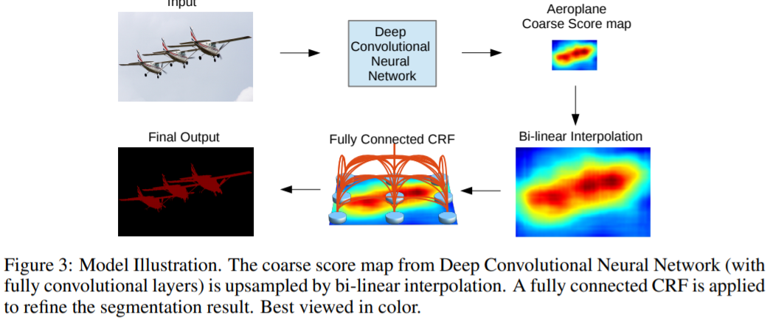
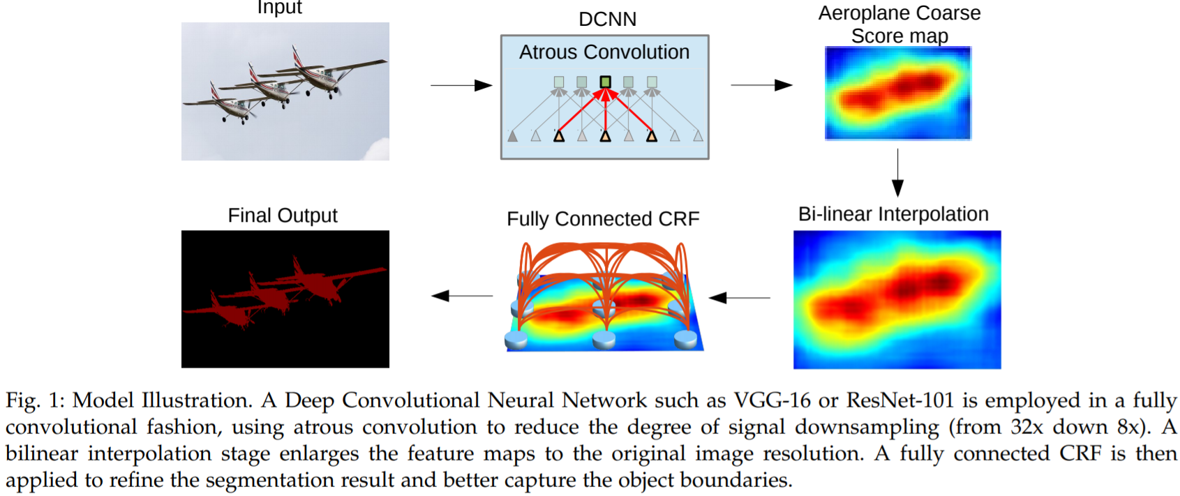
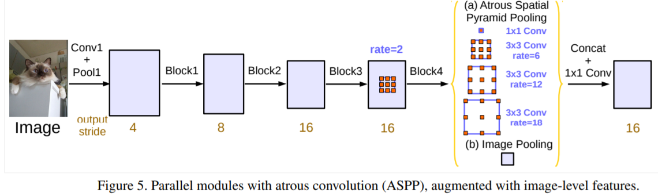
Method
DeepLabV1 vs DeepLabV2 vs DeepLabV3 vs DeepLabV3+

Slide 14


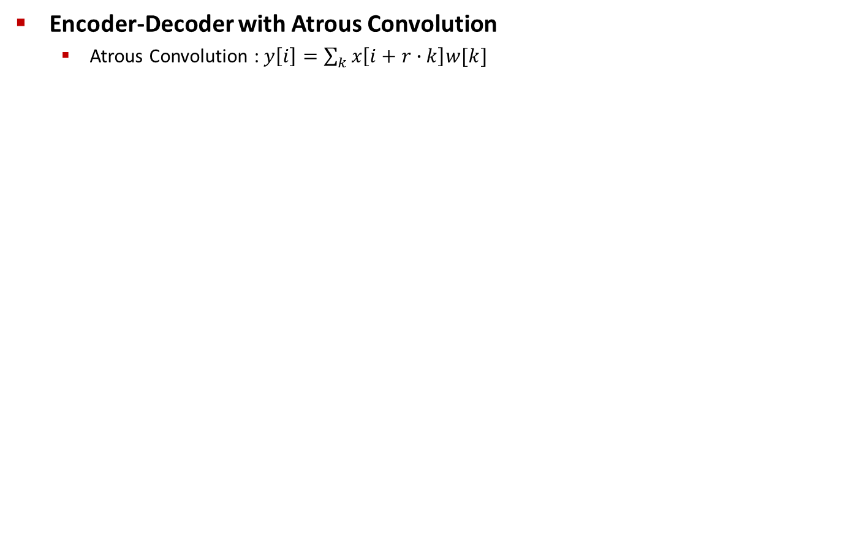
Method
Encoder-Decoder with Atrous Convolution
Atrous Convolution : $y\left[i\right]=\sum_{k}{x\left[i+r∙k\right]w[k]}$

Slide 15
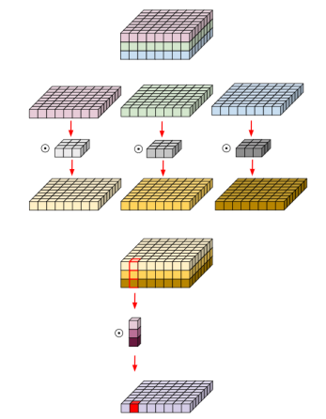
Method
Encoder-Decoder with Atrous Convolution
Depthwise Separable Convolution
Depthwise Convolution + Pointwise Convolution
Depthwise Convolution
Pointwise Convolution

Slide 16
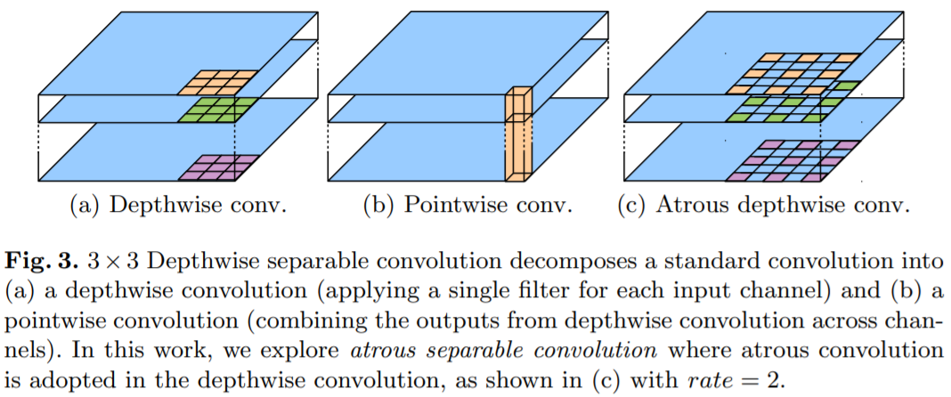
Method
Encoder-Decoder with Atrous Convolution
Atrous Depthwise Separable Convolution
Replacement

Slide 17
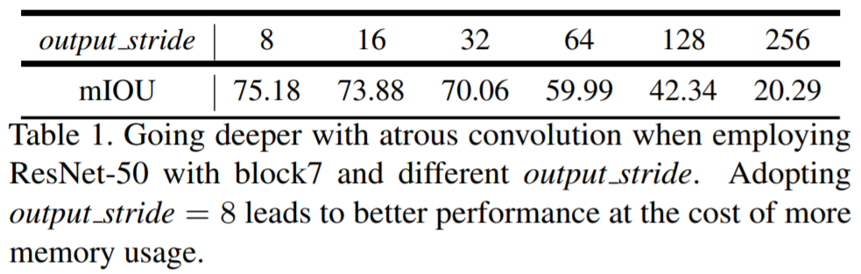
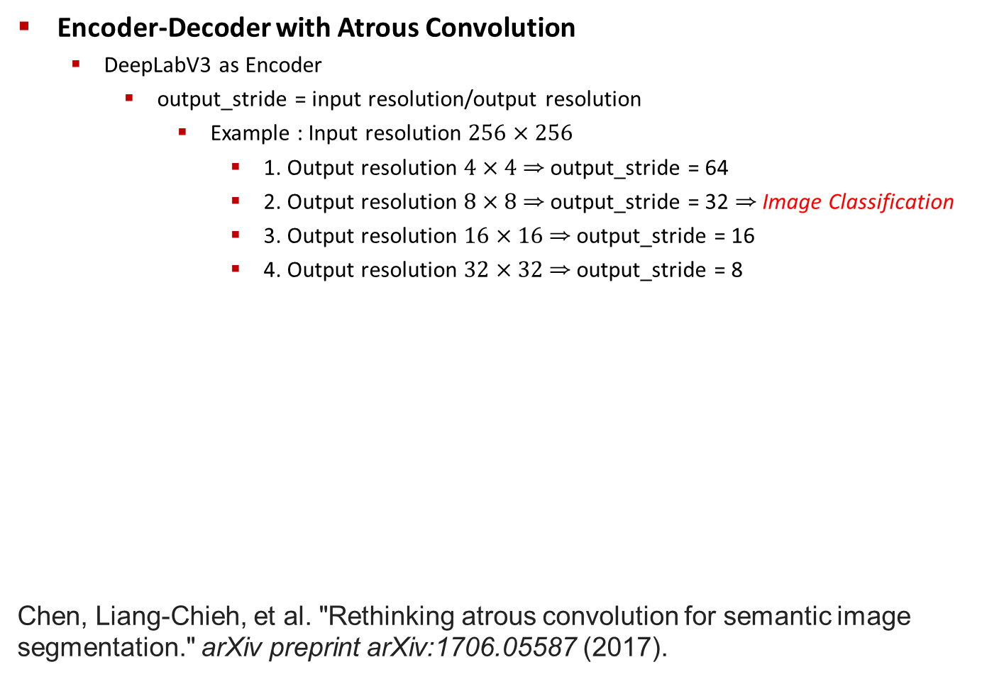
Method
Encoder-Decoder with Atrous Convolution
DeepLabV3 as Encoder
output_stride = input resolution/output resolution
Example : Input resolution $256×256$
1. Output resolution $4×4$ ⇒ output_stride = 64
2. Output resolution $8×8$ ⇒ output_stride = 32 ⇒ Image Classification
3. Output resolution $16×16$ ⇒ output_stride = 16
4. Output resolution $32×32$ ⇒ output_stride = 8
Chen, Liang-Chieh, et al. "Rethinking atrous convolution for semantic image segmentation." arXiv preprint arXiv:1706.05587 (2017).
Output feature map resolution ↓

Slide 18
Method
Encoder-Decoder with Atrous Convolution
DeepLabV3 as Encoder
Modifying Network
Remove the striding in the last one(or two) blocks
Applying the Atrous Convolution Correspondingly
last two block : rate = 2 and rate = 4

Slide 19
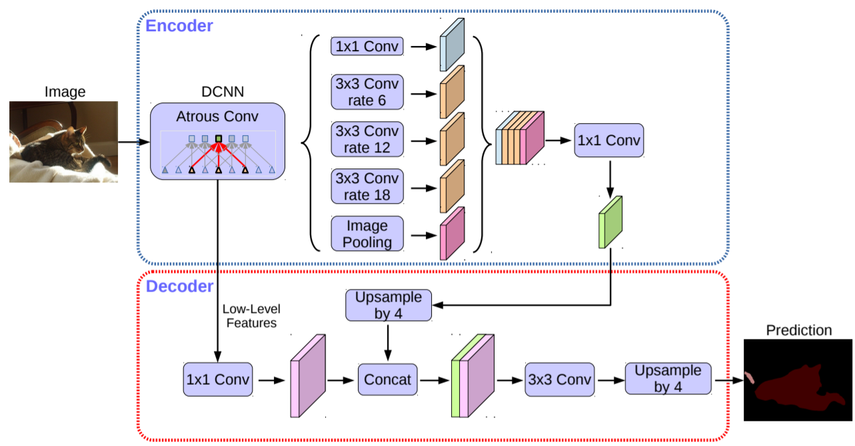
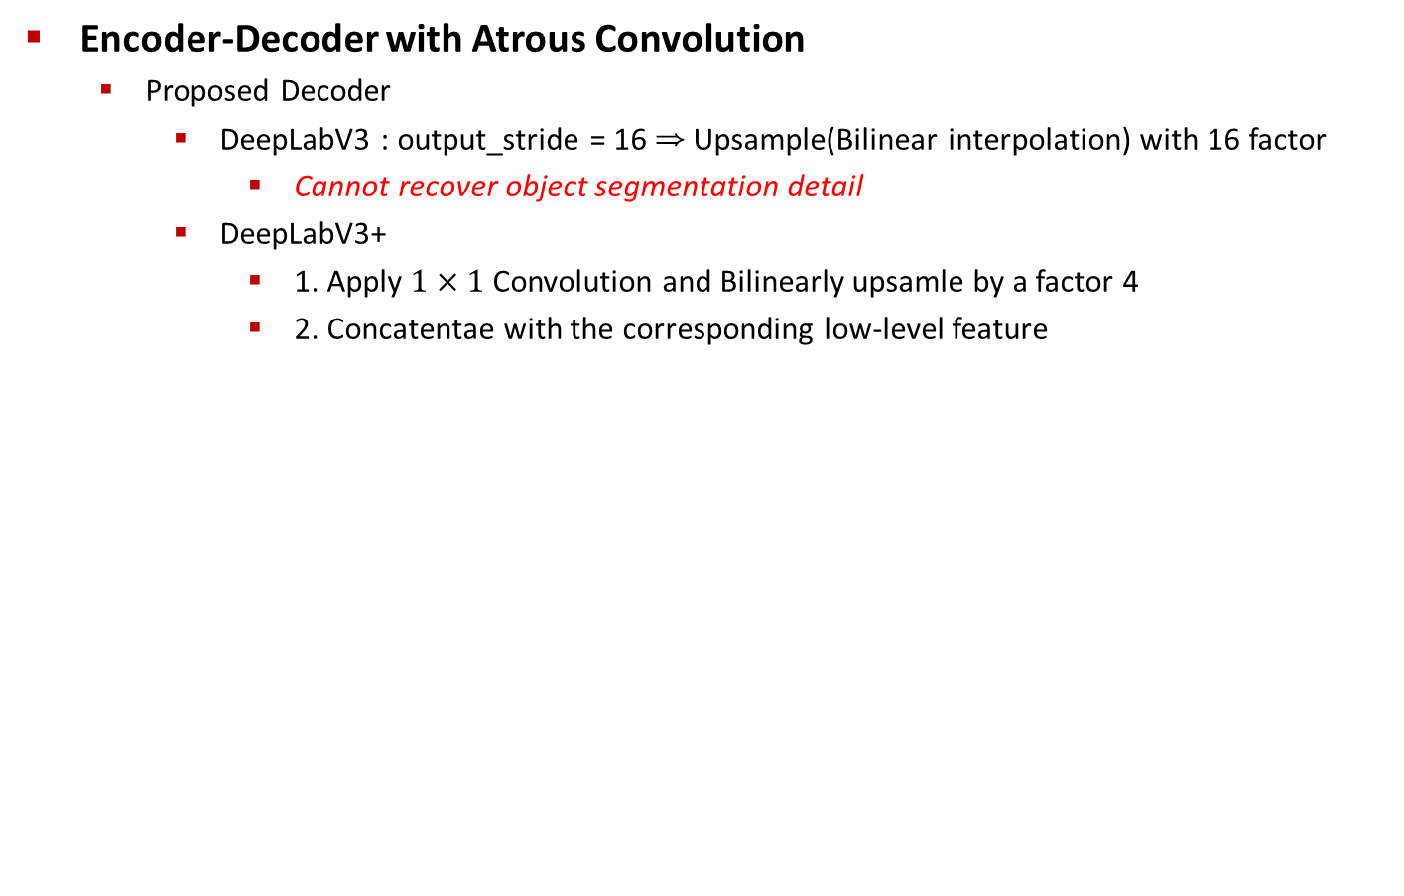
Method
Encoder-Decoder with Atrous Convolution
Proposed Decoder
DeepLabV3 : output_stride = 16 ⇒ Upsample(Bilinear interpolation) with 16 factor
Cannot recover object segmentation detail
DeepLabV3+
1. Apply $1×1$ Convolution and Bilinearly upsamle by a factor 4
2. Concatentae with the corresponding low-level feature

Slide 20
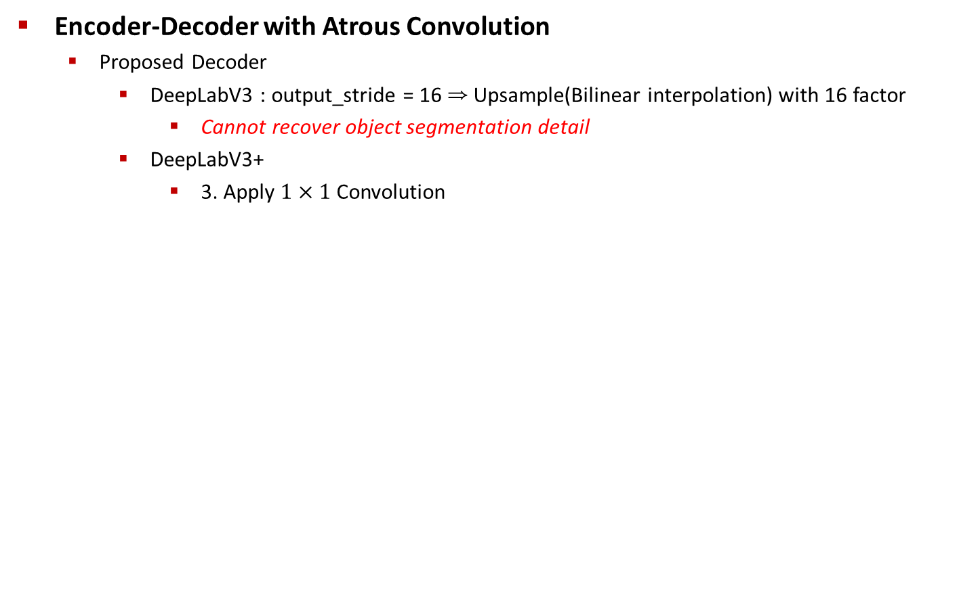
Method
Encoder-Decoder with Atrous Convolution
Proposed Decoder
DeepLabV3 : output_stride = 16 ⇒ Upsample(Bilinear interpolation) with 16 factor
Cannot recover object segmentation detail
DeepLabV3+
3. Apply $1×1$ Convolution

Slide 21
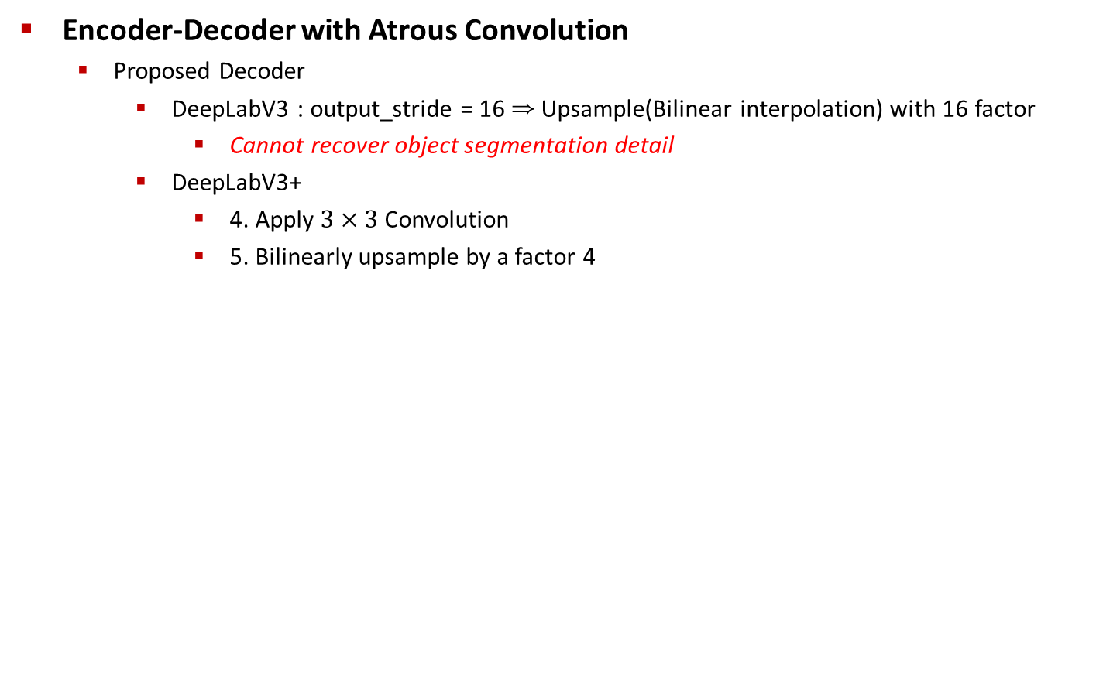
Method
Encoder-Decoder with Atrous Convolution
Proposed Decoder
DeepLabV3 : output_stride = 16 ⇒ Upsample(Bilinear interpolation) with 16 factor
Cannot recover object segmentation detail
DeepLabV3+
4. Apply $3×3$ Convolution
5. Bilinearly upsample by a factor 4

Slide 22
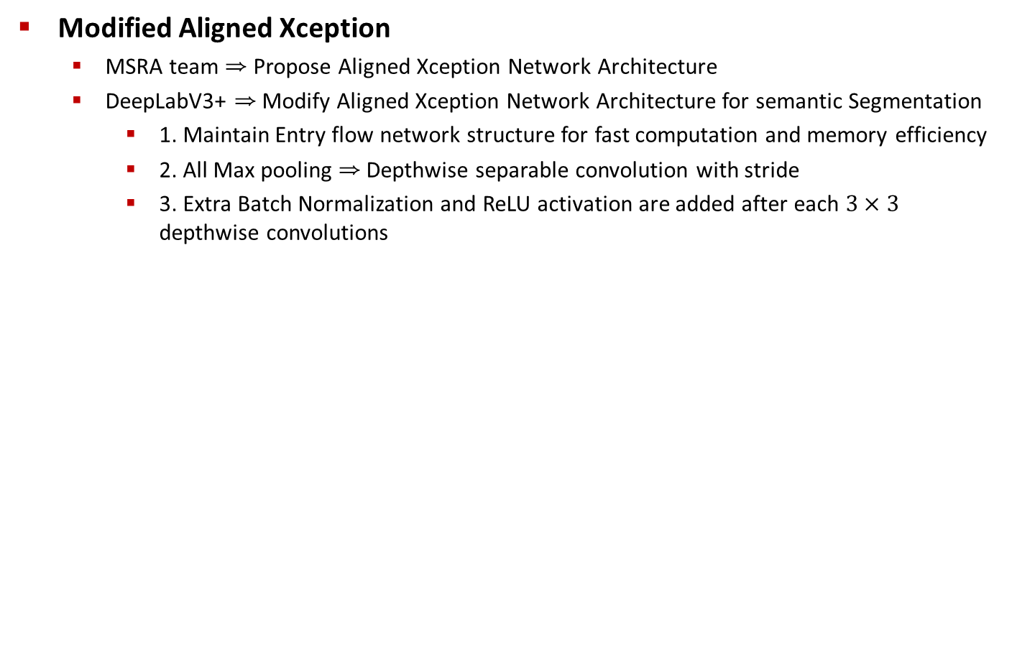
Method
Modified Aligned Xception
MSRA team ⇒ Propose Aligned Xception Network Architecture
DeepLabV3+ ⇒ Modify Aligned Xception Network Architecture for semantic Segmentation
1. Maintain Entry flow network structure for fast computation and memory efficiency
2. All Max pooling ⇒ Depthwise separable convolution with stride
3. Extra Batch Normalization and ReLU activation are added after each $3×3$ depthwise convolutions

Slide 23
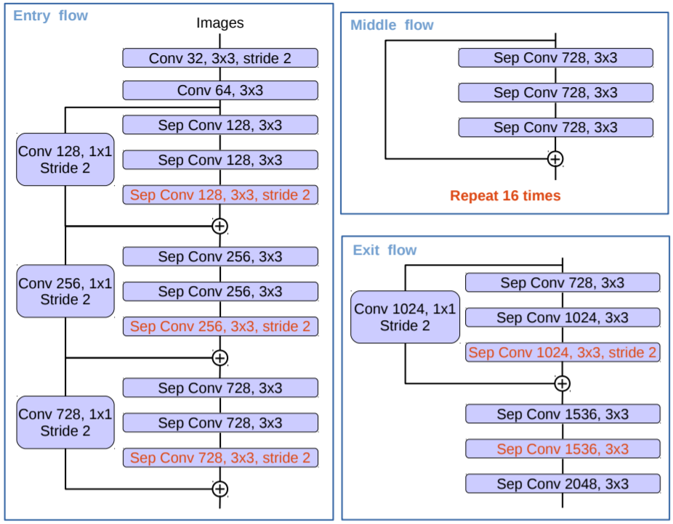
Method
Modified Aligned Xception

Slide 24
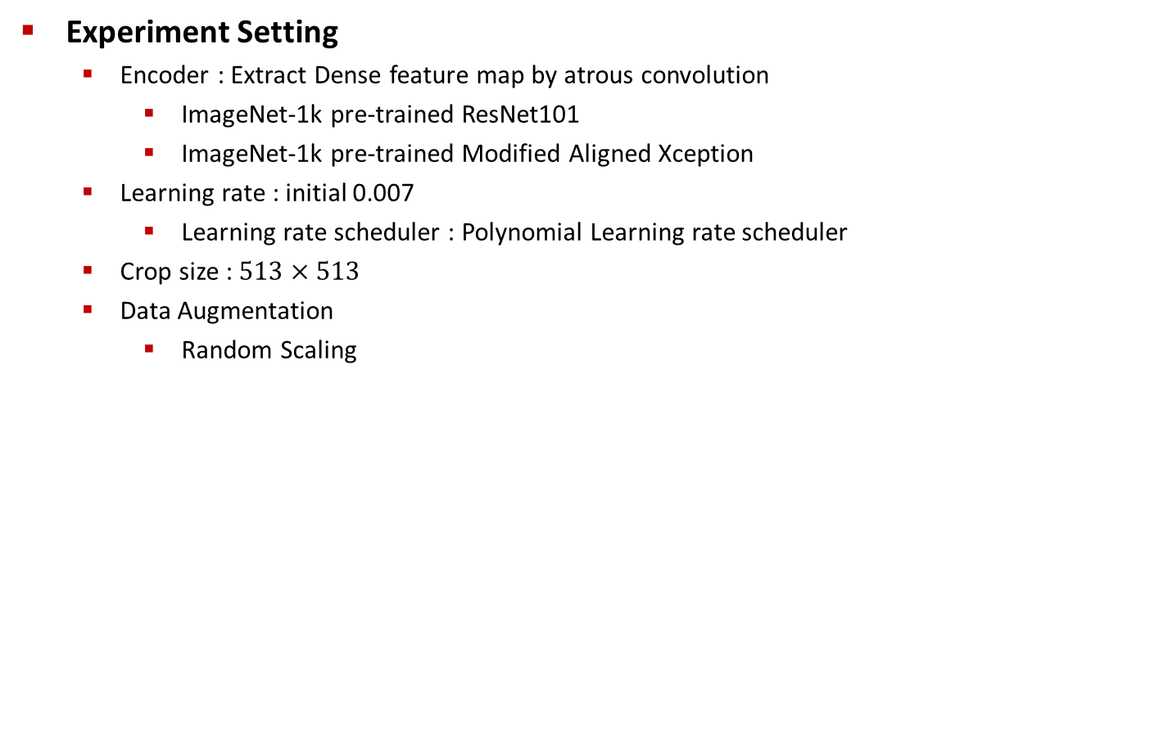
Experimental Evaluation
Experiment Setting
Encoder : Extract Dense feature map by atrous convolution
ImageNet-1k pre-trained ResNet101
ImageNet-1k pre-trained Modified Aligned Xception
Learning rate : initial 0.007
Learning rate scheduler : Polynomial Learning rate scheduler
Crop size : $513×513$
Data Augmentation
Random Scaling

Slide 25
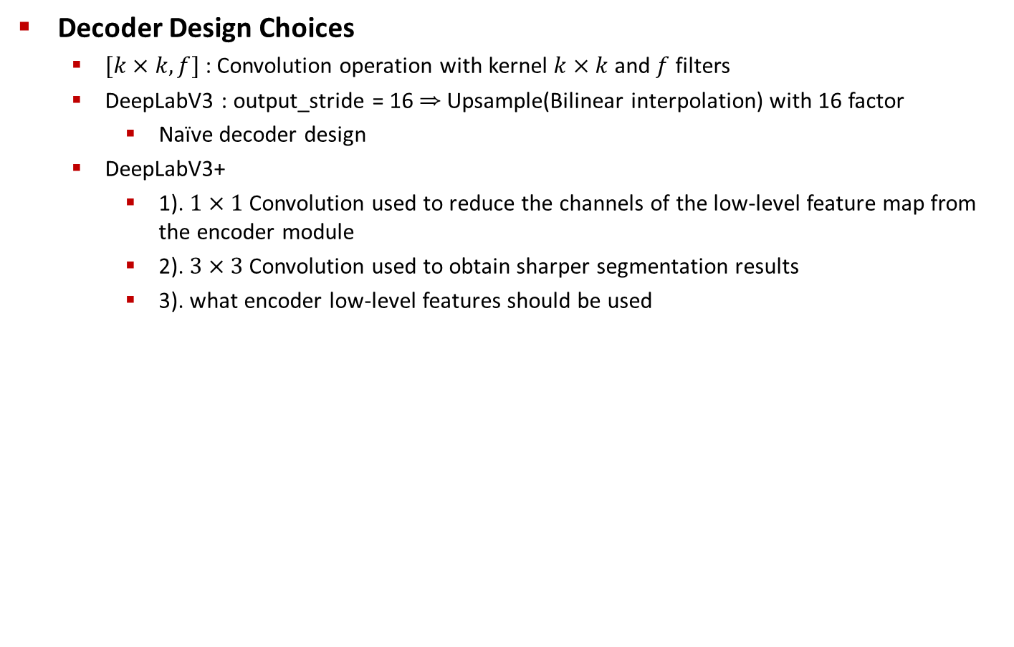
Experimental Evaluation
Decoder Design Choices
$[k×k,f]$ : Convolution operation with kernel $k×k$ and $f$ filters
DeepLabV3 : output_stride = 16 ⇒ Upsample(Bilinear interpolation) with 16 factor
Naïve decoder design
DeepLabV3+
1). $1×1$ Convolution used to reduce the channels of the low-level feature map from the encoder module
2). $3×3$ Convolution used to obtain sharper segmentation results
3). what encoder low-level features should be used

Slide 26
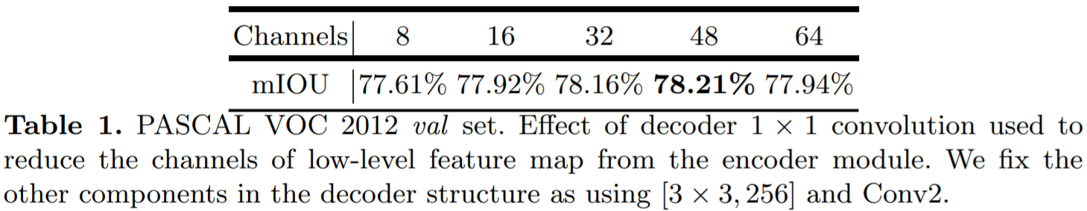
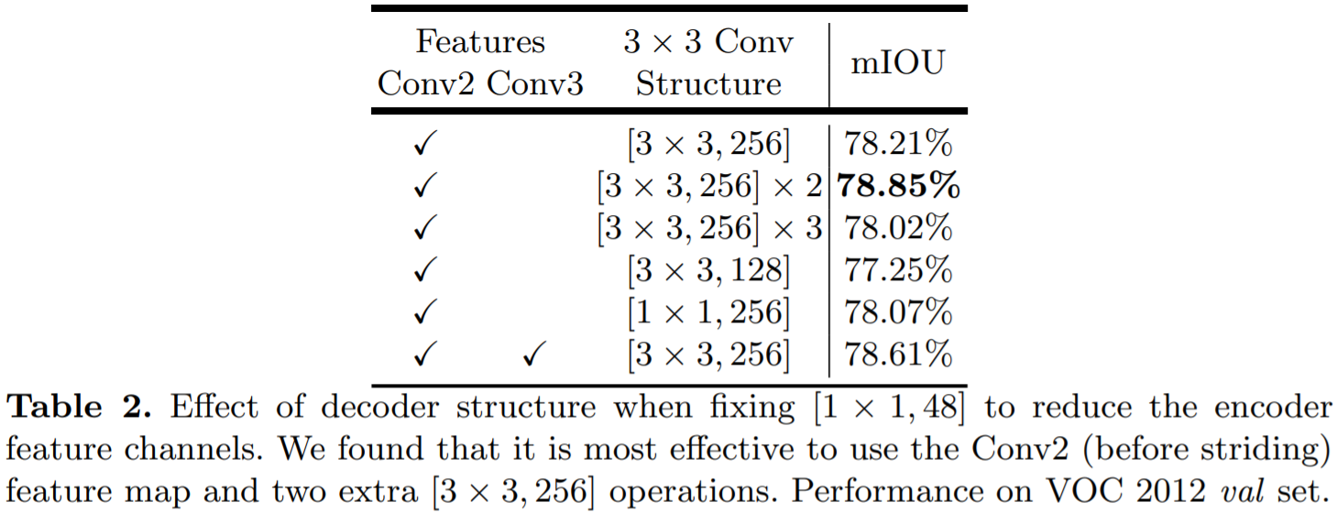
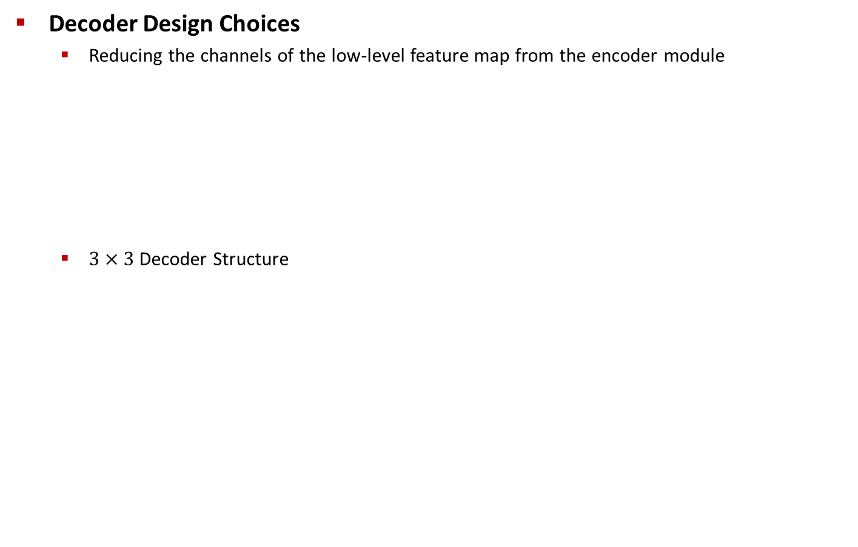
Experimental Evaluation
Decoder Design Choices
Reducing the channels of the low-level feature map from the encoder module
$3×3$ Decoder Structure

Slide 27
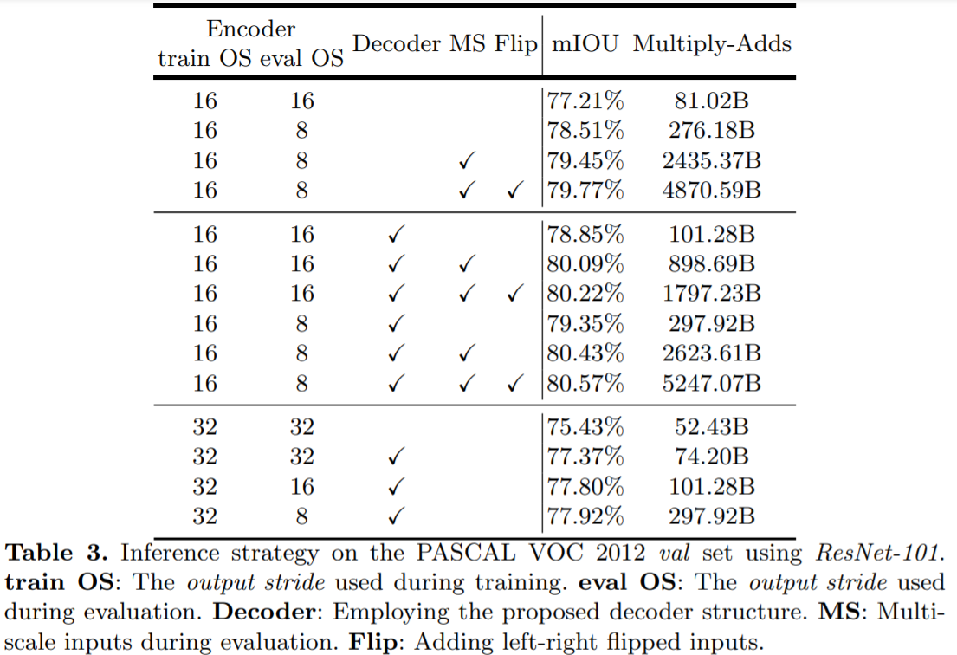
Experimental Evaluation
ResNet-101 as Network Backbone

Slide 28
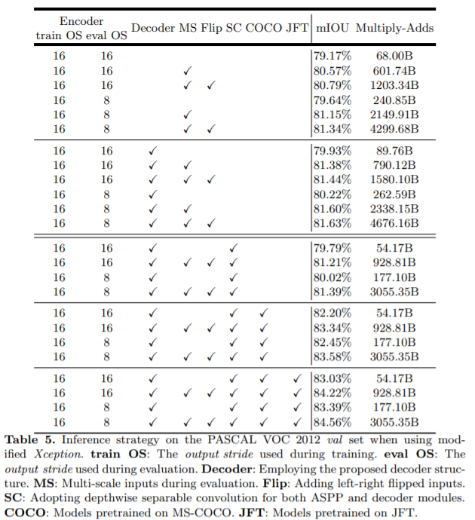
Experimental Evaluation
Modified Aligned Xception as Network Backbone

Slide 29
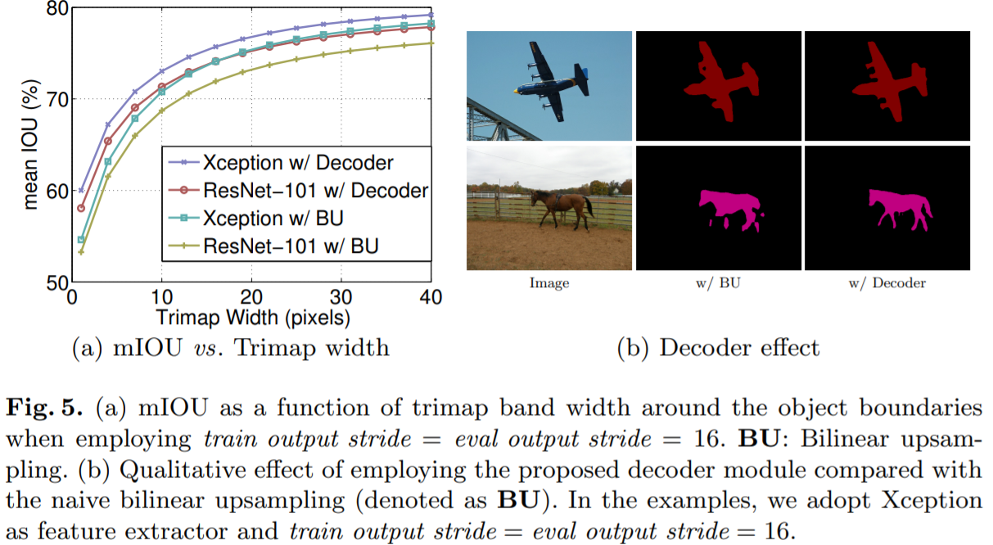
Experimental Evaluation
Improvement along Object Boundaries

Slide 30
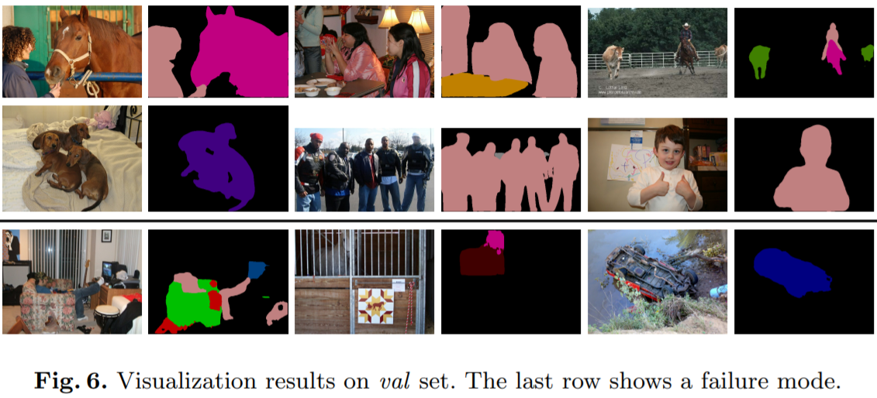
Experimental Evaluation
Visualization on PASCAL VOC 2012

